Slide 1
ISO FDIS 14001:2015 Explaining the Key Changes

Slide 2
Agenda
The long road from Rio - background to the revision
Why ISO 14001 is important
What are the key changes
What are the benefits
What we need to do
Your involvement
Our project team
Next steps
Notes:
ISO 14001 Environmental Management Systems is being revised and is expected to be published in September 2015.
The 2015 version will be a major revision of the standard and incorporates some new elements, enhancies some existing requirements and deletes some previous requirements.
This presentation covers the background to the revision, top level changes and what this means for our organization.

Slide 3
The long road from Rio…….
Increased understanding and awareness
Increased legislation
Global population growth
Brand reputation
Complex supply chains
Notes:
The first environmental management system was published as BS 7750 the year of the first Earth Summit in Rio. Soon afterwards, ISO used this as a basis for a new international standard and so ISO 14001 was born – published in 1996.
The world is changing – quickly. Sustainability and the Environment are inextricably linked and whereas a few years ago, it was a seen as a token gesture, things are changing and the business world is now realising the implications of an Environmental strategy and why!
Consumers are more aware and concerned about their impact on the environment which is changing buying habits and they are expecting companies to have the same ethical outlook
Increasing legislation requires organizations to manage and improve their environmental performance
The world population growth, currently running at an extra 1 billion people every 10-15 years is putting natural resources under extreme pressure – companies, organizations and society have a global responsibility to grow without compromising resources for future generations
Brand reputation – more than ever it is unacceptable to act irresponsibly – organizations are accountable for their actions like never before and need to manage their reputational risk which can cause negative publicity for brands
Finally, the increasingly complex supply chain means that transparency of suppliers is blurred and it’s harder to manage and control the environmental impact of all suppliers
In today’s world, environmental management systems have to be part of a sustainability and social responsibility policy. These systems help organizations to understand and optimize their environmental performance in line with legal and other important external requirements. Once an effective environmental management system is part of the overall strategic business objectives, it’ll help to manage internal, external, direct or indirect environmental impacts – both positive and negative .

Slide 4
Background to the revision
All standards are reviewed regularly to ensure they:
Adapt to a changing world
Place greater focus on the customer and enhanced customer satisfaction
Reflect increasingly complex organizational environments
Address the needs of all relevant parties/stakeholders
Major changes include:
A foundation for the integration with other management systems
Focus on leadership
Life cycle perspective and its impacts
Improved risk and opportunity management
Protecting the environment remains the primary focus
Notes:
ISO 14001 was first published in 1996 and minor changes where made in 2004, which made its requirements clearer and aligned it better with the ISO 9000 quality management series. This meant that organisations did not have to duplicate their efforts when implementing the two related systems.
The first revision was always going to be limited, because it was still early days for the standard and organisations in many countries were in the first stages of implementing it.
All standards are reviewed on a regular basis to ensure that they adapt to our changing world and still remain relevant – ISO 14001 is now being revised
The committee incorporated user feedback into the revision from the Future Changes Survey which directed some of the new requirements in the standard and to consider new approaches and methods in the field of EMS.
The major changes are
A change in structure to aid integration with other management systems to ensure a holistic approach across the organization
Leadership or top management buy in will have more focus. It is imperative that at this level that there is more commitment, responsiveness, active support and feedback. Their buy-in is critical for the success of the environmental management system, so they’ll be directly or indirectly tasked with specific responsibilities. These changes will help to raise the profile of an environmental management system, making sure top management looks at it from a strategic, tactical or operational level – it is no longer acceptable for it to be seen as an AOB on a business agenda
Finally, it now places greater emphasis on the concept of the ‘life cycle’ that impacts the environmental management system. It also looks at how organizations control changes and outsource specific things
Now in an ever changing world – both from a technology perspective but also a realisation of how businesses are becoming more aware of how being sustainable has a real impact on the environment around us and how they are perceived by their customers, then it was agreed that there was a need to update the current 14001 Environmental Management System. In addition, a common format across the major Management Systems will ensure that implementation across various standards will make implementation easier.

Slide 5
Why ISO 14001 is important
ISO 14001 has helped thousands of organizations throughout the world to
Comply with regulations
Inspire trust in their business
Reduce waste and defects
Manage business risk
Increase competitiveness
Notes:
Since it was first published ISO 14001 has helped thousands of organizations throughout the world to improve their environmental performance.
We have gained similar benefits to those listed here helping us comply with regulations, reduce waste and defects and save money
ISO 14001 is certainly a powerful way for a business to demonstrate to its stakeholders, supply chain and customers that it takes environmental management seriously
Embracing environmental management has proven to have an array of additional benefits for organisations with recent research from Harvard Business School finding that socially responsible companies not only attract the best talent but also outperform businesses that have a low-sustainability rating

Slide 6
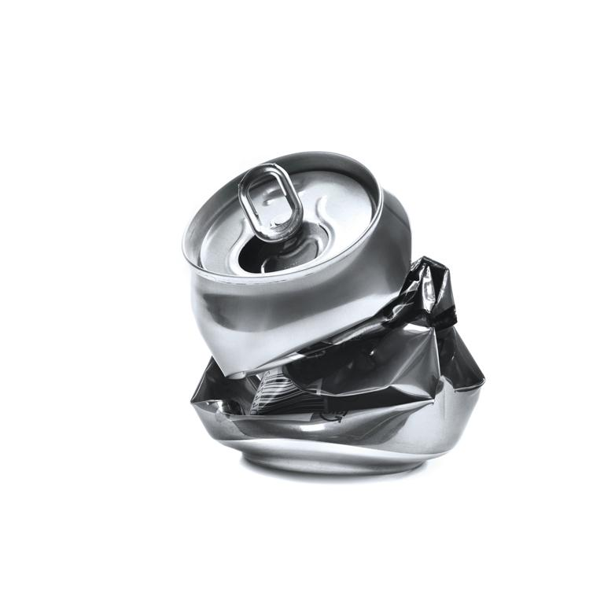
ISO 14001 – Key changes
Leadership
Risk
Greater emphasis for senior managers to be involved in the management system.
Context of Organization
Improved risk and opportunity management.
Environmental Importance
Increased focus on environment and improving performance.
Annex SL
Relevant needs of interested parties is emphasized.
Enhance alignment with other ISO management system standards.
Notes:
The new standard contains a number of new areas and requirements which are will require us to revisit our EMS
There is an increased focus on the environment especially improving environmental performance. It also requires more lifecycle management – from cradle to grave
The new standard requires greater involvement in the environmental management system by the leadership team to ensure it is effective. This will ensure compatibility between the environmental policy and our strategic direction – improving performance, reducing waste and saving money
Risk based thinking is now incorporated and requires us to review and address risks and opportunities
Context of the organization is another new requirement – we now need to understand our interested parties ie customer, suppliers etc and their needs
Finally the new standard has been written using a new high level structure – Annex SL which is the new common framework for management system standards which makes it easier to align our EMS with other standards

Slide 7
ISO 14001 – Key differences
ISO 14001:2004 | ISO FDIS 14001:2015
 | 0 Introduction
1 Scope | 1 Scope
2 Normative references | 2 Normative references
3 Terms and definitions | 3 Terms and definitions
4 Environmental system requirements | 4 Context of the organization | Essentially a new requirement to understand the needs and expectations of interested parties
4.1 General requirements | 5 Leadership | Enhanced requirements
4.2 Environmental policy | 6 Planning | Significant change Enhanced requirements
4.4 Implementation and operation | 7 Support | Enhanced requirement New requirement
4.5 Checking | 8 Operation | New requirement Enhanced requirement Simplified requirement Enhanced requirement
4.6 Management review | 9 Performance evaluation | New requirement
 | 10 Improvement | More structured approach
Notes:
This slide covers the key clauses of ISO 14001:2004 and ISO 14001:2015
Clause 4 covers ‘context of the organization’ and is a new requirement – we need to understand the environment in which we operate, interested parties and their needs
Clause 5 – covers the enhanced focus on leadership – the new standard requires greater involvement in the EMS by the leadership team to ensure its effective
Clause 6 - Planning is probably the biggest area of change - it focuses on the development and use of a planning process rather than a procedure to address both a range of factors and the risk associated with such factors
Clause 7 – the requirement that organizations shall determine and provide the necessary resources to establish, implement, maintain and continually improve the EMS. Simply expressed, this is a very powerful requirement covering all EMS resource needs.
Clause 8 - This clause deals with the execution of the plans and processes
Clause 9 – we need to evaluate and monitor our environmental performance and effectiveness
Clause 10 – finally due to the new structure and risk focus of the standard, there are no preventive action requirements in this clause. However, there are
some new more detailed corrective action requirements

Slide 8
Benefits of the new standard
Bringing Environmental Management into the heart of our business
Environmental management will be integrated and aligned with our business strategies improving sustainability, saving money and preserving the world’s natural resources.
Improved Lifetime Environmental Performance
This holistic approach will identify further opportunities for improved environmental performance saving resources and costs
An Integrated Approach
It will be easier to implement more than one management system providing a more holistic view leading to cost savings
Leadership
Greater involvement by our leadership team will ensure that we’ll all be motivated towards the organizations goals and objectives

Slide 9
What we need to do
Set up a project team to manage the changes
Communicate the project across the whole organization
Create an implementation plan and monitor progress
Highlight the changes as opportunities for improvement
Make changes to our documentation to reflect the new structure (as necessary)
Implement the new requirements on leadership and context of the organization
Review the effectiveness of our current control set
Carry out an impact assessment
Notes:
The revision allows us to take a completely fresh look at our EMS in line with our business objectives and the new requirements
We will need to consider factors affecting our environmental performance so that significant risks and opportunities can be identified and aligned with the strategic direction of the organization.
This strategic focus will result in optimizing the performance of our EMS making it more sustainable, saving money and helping preserve the world’s resources for future generations

Slide 10
Your involvement
You need to be aware of
Our environmental policy:
The significant environmental impacts
How your work may impact the policy
Your contribution to the effectiveness of the EMS
Implication of not conforming with our EMS
Notes:
The standard is very clear about ensuring the competency of people doing work that affects its environmental performance as well as your awareness.
You need to ensure that you are aware of our environmental policy, the significant environmental aspects and related actual or potential impacts associated with your work.
You need to understand how you contribute to the effectiveness of the environmental management system requirements including enhanced environmental performance
Finally you need to be aware of the implications of not conforming with the environmental management system requirements including compliance obligations
Communication is the key and we will ensure that all of this will be communicated to you on a regular basis – and we want your contributions to continual improvement.

Slide 11
Our Project Team
Insert Names
Notes:
We have set up a project team to review of current EMS, the new standard requirements and develop an implementation plan….
Our team is ………
Please don’t hesitate to contact anyone of us if you need further information

Slide 12
Next Steps/Timescales
Insert timescales…
Notes:
Finally timescales – we are planning to transition by XXX date and these are the key stages

